Slide 1
Army Operations
THE MEDIOCRE TEACHER TELLS. THE GOOD TEACHER EXPLAINS. THE SUPERIOR TEACHER DEMONSTRATES. THE GREAT TEACHER INSPIRES.
WILLIAM ARTHUR WARD

Slide 2
ARMY OPERATIONS
In Dec 1989 the US Army participated in a live fire FTX in Panama.This operation involved all branches: the Army, Navy, Air Force and Marines in a joint operation to accomplish objectives set by the Commander in Chief. In order to succeed all levels of command had to develop plans and execute them effectively.
You as a future instructor, must know and fully understand the doctrine used by the Army.You must be able to answer questions from a doctrinal source, NOT a Battalion/Company/Platoon SOP.

Slide 3
TERMINAL LEARNING OBJECTIVE
ACTION: Identify Army Operations as outlined in FM 3-0 and FM 3-90.
CONDITION: Given advance sheet and reading assignments.
STANDARD: Identify Army Operations as outlined in FM 3-0, FM 3-90 and achieve a 70% pass on the overall testing.

Slide 4
ADMINISTRATIVE DATA
SAFETY REQUIREMENTS: NONE
RISK ASSESSMENT: LOW
ENVIRONMENTAL: NONE
EVALUATION YES

Slide 5
ENABLING LEARNING OBJECTIVE A
ACTION: Determine the role of doctrine.
CONDITION: Given advance sheet and reading assignments.
STANDARD: Determine the role of doctrine IAW FM 3-0, FM 3-90, and achieve a 70% pass on the overall testing.

Slide 6
ARMY OPERATIONS
DOCTRINE
TACTICS
TECHNIQUES
PROCEDURES

Slide 7
ARMY OPERATIONS DOCTRINE
“ DOCTRINE IS THE CONCISE EXPRESSION OF HOW AMERICA’S ARMY FORCES CONTRIBUTE TO UNIFIED ACTION IN CAMPAIGNS, MAJOR OPERATIONS, BATTLES, AND ENGAGEMENTS”.
FM 3-0 pg1-14

Slide 8
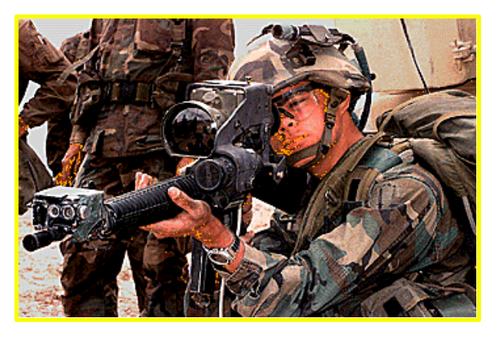

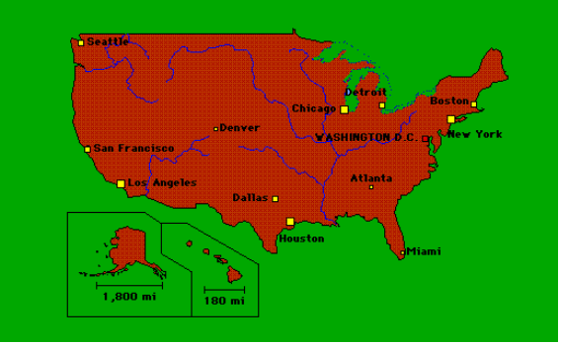
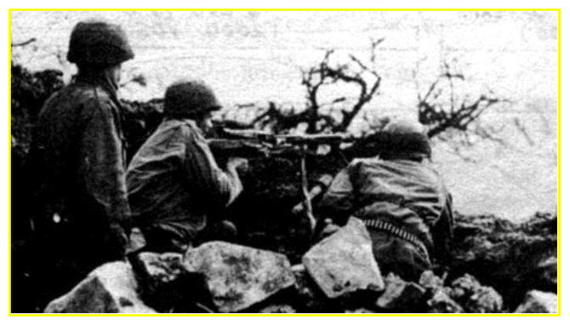



THE SOURCES OF DOCTRINE
POLITICAL GOALS
TECHNOLOGICAL ADVANCES
AMERICAN SOCIETY
HISTORICAL LESSONS
MONETARY RESOURCES
DOCTRINE
FM 3-90
TACTICS
TECHNIQUES
FM 71-1
FM 3-0
OPERATIONS
PROCEDURES
TANK AND
MECHANIZED
INFANTRY
COMPANY TEAM
TMs
HEADQUARTERS
DEPARTMENT OF
THE ARMY

Slide 9
TACTICS
“TACTICS IS THE EMPLOYING OF UNITS IN COMBAT.”
FM 3-90 pg1-1

Slide 10
TACTICS
TACTICS IS BATTLEFIELD PROBLEM SOLVING - USUALLY RAPID AND DYNAMIC IN NATURE.
THIS INVOLVES:
THE ORDERED ARRANGEMENT.
MANEUVER OF UNITS IN RELATION TO EACH OTHER.
TERRAIN.
TRANSLATE POTENTIAL COMBAT POWER WITH THE RESULT OF A VICTORIOUS BATTLE AND ENGAGEMENT.
FM 3-90 pg1-1

Slide 11
TACTICS
A TACTICIAN MUST UNDERSTAND AND MASTER THE:
THE ART OF TACTICS
THE SCIENCE OF TACTICS
FM 3-90 pg-1-3

Slide 12
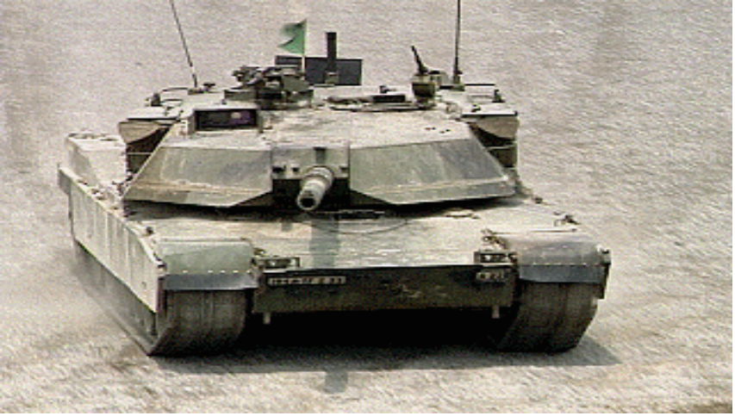
TECHNIQUES
DETAILED METHODS TO PERFORM MISSIONS.
METHODS FOR USING TROOPS AND EQUIPMENT.
MAY BE CHANGED AS NEEDED.
NOT THE ONLY METHOD.
FM 3-90 pg 1-2

Slide 13
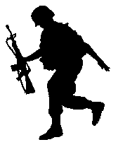
PROCEDURES
PRESCRIPTIVE IN NATURE.
STANDARDIZED.
DETAILED COURSES OF ACTION.
FM 3-90 pg1-2

Slide 14
ENABLING LEARNING OBJECTIVE B
ACTION: Identify the levels of war.
CONDITION: Given advance sheet and reading assignments.
STANDARD: Identify the levels of war IAW FM 3-90 and achieve a 70% pass on the overall testing.

Slide 15
LEVELS
OF
WAR
“SEPARATE GROUND, SEA, AND AIR WARFARE IS GONE FOREVER. IF EVER AGAIN WE SHOULD BE INVOLVED IN WAR, WE WILL FIGHT IN ALL ELEMENTS, WITH ALL SERVICES, AS ONE SINGLE CONCENTRATED EFFORT. PEACETIME PREPARATORY AND ORGAINZATIONAL ACTIVITY MUST CONFORM TO THIS FACT.
PRESIDENT DWIGHT D. EISENHOWER, 3 APRIL 1958
FM 3-0 pg2-1

Slide 16
LEVELS OF WAR
STRATEGIC
OPERATIONAL
TACTICAL
FM 3-0 pg2-2
Notes:
Defied: entirerange of military operations and links between tactical action and strategic obj

Slide 17
THE LEVELS OF WAR
ARMY OPERATIONS
STRATEGIC
STRATEGIC IS THE ART AND SCIENCE OF DEVELOPING AND EMPLOYING ARMED FORCES AND OTHER INSTRUMENTS OF NATIONAL POWER.
THEATERS OR AREAS OF OPERATIONS, IT LINKS THE TACTICAL EMPLOYMENT OF FORCES TO STRATEGIC OBJECTIVES.
THE LEVEL IN WHICH INVOLVE THE EMPLOYMENT OF UNIT INTO COMBAT.
OPERATIONAL
TACTICAL
FM 3-0 pg 2-2 thru 2-5

Slide 18
ENABLING LEARNING OBJECTIVE C
ACTION: Determine the elements of Combat Power.
CONDITION: Given advance sheet and reading assignments.
STANDARD: Determine the elements of Combat Power IAW FM 3-0, FM 3-90, and achieve a 70% pass on the overall testing.

Slide 19
Fundamentals of Full Spectrum Operations
Offense
Stability
Principles
of War
Decisive
Operations
Defense
Operational
Framework
Support
Maneuver
Firepower
Leadership
Protection
Information
Tenets
Elements of Combat
FM 3-0 pg4-3

Slide 20
COMBAT POWER
APPLIED AGAINST AN OPPONENT AT A GIVEN TIME.
A COMBINATION OF THE EFFECTS OF:
MANEUVER
FIREPOWER
LEADERSHIP
PROTECTION
&
INFORMATION
FM 3-0 pg 4-3

Slide 21
ANALYZE RELATIVE COMBAT POWER
ENEMY ENEMY FRIENDLY FRIENDLY
STRENGTHS WEAKNESS STRENGTHS WEAKNESS
MANEUVER
FIREPOWER
LEADERSHIP
PROTECTION
INFORMATION

Slide 22
MANEUVER
BOTH ADVANTAGE AND DANGER ARE INHERENT IN MANEUVER.
SUN TU
400-320 B.C.
THE ART OF WAR
(QDX-1)

Slide 23
MANEUVER
THE EMPLOYMENT OF FORCES, THROUGH MOVEMENT COMBINED WITH FIRE OR FIRE POTENTIAL,TO ACHIEVE A POSITION OF ADVANTAGE WITH RESPECT TO THE ENEMY TO ACCOMPLISH THE MISSION.
IS THE MEANS BY WHICH A COMMANDER CAN CONCENTRATE COMBAT POWER TO ACHIEVE SURPRISE, SHOCK, MOMENTUM, AND DOMINANCE.
FM 3-0 pg 4-4

Slide 24
FIREPOWER
“FIREPOWER KILLS.”
MARSHAL OF FRANCE- HERNIA-PHILIPPE PETUNIA
1856

Slide 25
FIREPOWER
PROVIDES THE DESTRUCTIVE FORCE
ESSENTIAL TO OVERCOMING
THE ENEMY’S ABILITY
AND WILL TO
FIGHT.
FM 3-0 pg 4-6

Slide 26
LEADERSHIP
NO MAN IS A LEADER UNTIL HIS APPOINTMENT IS RATIFIED IN THE MINDS AND HEARTS OF HIS MEN.
THE INFANTRY JOURNAL 1948

Slide 27

LEADERSHIP
THE MOST DYNAMIC ELEMENT OF COMBAT POWER. CONFIDENT, AUDACIOUS, AND COMPETENT LEADERSHIP.
IT PROVIDES:
PURPOSE
DIRECTION
MOTIVATION
FM 3-0 pg 4-7

Slide 28
PROTECTION

Slide 29
PROTECTION
PRESERVATION OF THE FIGHTING POTIENTIAL OF A FORCE SO THE CMDR CAN APPLY MAXIMUM FORCE AT A DECISIVE PLACE AND TIME.
PROTECTION HAS FOUR COMPONENTS:
1. FORCE PROTECTION- THE PRIMARY COMPONENT, MINIMIZES THE EFFECTS OF ENEMY FIREPOWER, MANEUVER, AND INFORMATION.
2. FIELD DISCIPLINE- A SECOND COMPONENT OF PROTECTION, GUARDS SOLDIERS FROM THE PHYSICAL AND PSYCHOLOGICAL EFFECT OF THE ENVIRONMENT.
3. SAFETY- REDUCE THE INHERENT RISK OF NONBATTLE DEATHS AND INJURIES. (ie.RISK ASSESSMENTS)
4. FRATRICIDE- THE UNINTENTIONAL KILLING OR WOUNDING OF FRIENDLY PERSONNEL BY FRIENDLY FIREPOWER.
FM 3-0 pg4-8

Slide 30
INFORMATION

Slide 31
INFORMATION
Information enhances leadership and magnifies the effects of maneuver,firepower,and protection.
For example, superior understanding of the situation allows commanders to avoid enemy engagement areas, while concentrating fires and maneuver at the decisive place and time.
HUMAN
CNN
PHYOPS
FM 3-0 pg 4-10

Slide 32
ENABLING LEARNING OBJECTIVE D
ACTION: Determine the nine principles of war
CONDITION: Given advance sheet and reading assignments
STANDARD: Determine the nine principles of war IAW FM 3-0, FM 3-90 and achieve a 70% pass on the overall testing

Slide 33
PRINCIPLES
OF
WAR
THE ART OF WAR OWNS CERTAIN ELEMENTS AND FIXED PRINCIPLES. WE MUST ACQUIRE THAT THEORY, AND LODGE IT IN OUR HEADS- OTHERWISE WE WILL NEVER GET VERY FAR.
FREDERICK THE GREAT, 1760

Slide 34
PRINCIPLES OF WAR
THE US ARMY PUBLISHED ITS FIRST DISCUSSION OF THE PRINCIPLES OF WAR IN A 1921 TRAINING REGULATION.
TAKEN FROM THE WORK OF BRITISH MAJOR GENERAL J.F.C. FULLER.
DEVELOPED FOR HIS OWN ARMY IN W W I.

Slide 35
PRINCIPLES OF WAR
OBJECTIVE
OFFENSIVE
MASS
ECONOMY OF FORCE
MANEUVER
UNITY OF COMMAND
SECURITY
SURPRISE
SIMPLICITY
FM 3-0 pg 4-12

Slide 36
OBJECTIVE
“YOU KNOW, YOU NEVER DEFEATED US ON THE BATTLEFIELD,”
SAID THE AMERICAN COLONEL.
THE NORTH VIETNAMESE COLONEL PONDERED THIS REMARK FOR A MOMENT.
“THAT MAY BE SO ,” HE REPLIED, “BUT IT IS ALSO IRRELEVANT.”
CONVERSATION IN HANOI, US AND NVA NEGOTIATIONS, 1975

Slide 37
OBJECTIVE
DIRECT EVERY MILITARY OPERATION TOWARDS A CLEARLY DEFINED, DECISIVE, AND ATTAINABLE OBJECTIVE.
ENSURING ALL ACTIONS CONTRIBUTE TO THE GOALS OF THE HIGHER HEADQUARTERS.
HAVING A CLEAR UNDERSTANDING OF THE EXPECTED OUTCOME AND ITS IMPACT.
FM 3-0 pg 4-12

Slide 38
OFFENSIVE

Slide 39
OFFENSIVE
SEIZE, RETAIN, AND EXPLOIT THE INITIATIVE.
OFFENSIVE ACTIONS ARE THOSE TAKEN TO DICTATE THE NATURE, SCOPE, AND TEMPO OF AN OPERATION
OFFENSIVE OPERATION ARE ESSENTIAL TO MAINTAIN THE FREEDOM OF ACTION NECESSARY FOR SUCCESS, EXPLOIT VULNERABLILITIES, AND REACT TO RAPIDLY CHANGING SITUATIONS AND UNEXPECTED DEVELOPMENTS
FM 3-0 pg 4-13

Slide 40
MASS
USE THE MOST SOLID TO ATTACK THE MOST EMPTY.
TS`AO TS`AO
155-220

Slide 41
MASS
Concentrate the effect of combat power at
the decisive place and time
FM 3-0 pg 4-13

Slide 42
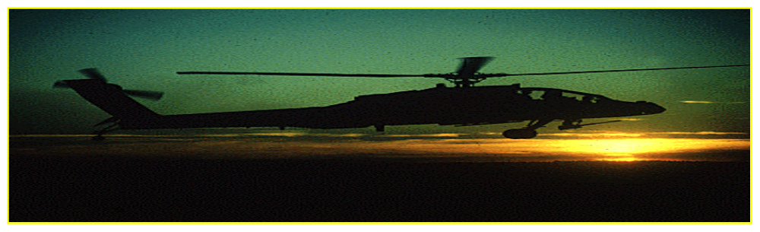
MANEUVER
NEARLY ALL BATTLES WHICH ARE REGARDED AS MASTERPIECES OF THE MILITARY ART, HAVE BEEN BATTLES OF MANEUVER.
WINSTON CHURCHILL, 1923

Slide 43
MANEUVER
PLACE THE ENEMY IN A POSITION OF DISADVANTAGE THROUGH THE FLEXIBLE APPLICATION OF COMBAT POWER.
EFFECTIVE MANEUVER KEEPS THE ENEMY OFF BALANCE BY MAKING THEM CONFRONT NEW PROBLEMS AND NEW DANGERS FASTER THAN HE CAN DEAL WITH THEM.
FM 3-0 pg 4-14

Slide 44
SECURITY

Slide 45
SECURITY
NEVER PERMIT THE ENEMY TO ACQUIRE AN UNEXPECTED ADVANTAGE:
SECURITY RESULTS FROM MEASURES TAKEN TO PROTECT YOURSELF FROM SURPRISE, INTERFERENCE, SABOTAGE, AND THEATS.
AREA
LOCAL
OPSEC
FM 3-0 pg4-14

Slide 46
SURPRISE
TO BE DEFEATED IS PARDONABLE;
TO BE SURPRISED - NEVER!
NAPOLEON BONAPARTE

Slide 47
SURPRISE
STRIKE THE ENEMY AT A TIME AND PLACE OR IN A MANNER FOR WHICH HE IS UNPREPARED.
THE FACTORS CONTRIBUTING TO SURPRISE TO INCLUDE SPEED AND INFORMATION SUPERIORITY.
FM 3-0 pg 4-14

Slide 48
SIMPLICITY
IN WAR, ONLY WHAT IS SIMPLE CAN SUCCEED.
FIELD MARSHAL VON HINDENBURG, 1932.

Slide 49

SIMPLICITY
PREPARE CLEAR, UNCOMPLICATED PLANS AND CONCISE ORDERS TO ENSURE THOROUGH UNDERSTANDING.
SIMPLE PLANS AND CLEAR, CONCISE ORDERS MINIMIZE MISUNDERSTANDING AND CONFUSION.
K.I.S.S.
FM 3-0 pg 4-15

Slide 50
UNITY OF COMMAND
NOTHING IS SO IMPORTANT IN WAR AS AN UNDIVIDED COMMAND.
NAPOLEON BONAPARTE 1831

Slide 51
UNITY OF COMMAND
FOR EVERY OBJECTIVE, ENSURE UNITY OF EFFORT UNDER ONE RESPONSIBLE COMMANDER.
UNITY OF COMMAND:
MEANS THAT A SINGLE COMMANDER DIRECTS AND COORDINATES THE ACTION OF ALL FORCES TOWARDS A COMMON OBJECTIVE.
UNITY OF EFFORT:
REQUIRES COORDINATION AND COOPERATION AMONG FORCES-EVEN THOUGH THEY MAY NOT NECESSARILY BE PART OF THE SAME COMMAND STRUCTURE-TOWARD A COMMONLY RECOGNIZED OBJECTIVE.
FM 3-0 pg 4-14

Slide 52
ECONOMY OF FORCE
TO ME AN UNNECESSARY ACTION, OR SHOT, OR CASUALTY, WAS NOT ONLY A WASTE, BUT A SIN.
T.E. LAWRENCE 1918

Slide 53
ECONOMY OF FORCE
ALLOCATE MINIMUM ESSENTIAL COMBAT POWER TO SECONDARY EFFORTS.
ECONOMY OF FORCE IS THE RECIPROCAL OF MASS. EMPLOY ALL COMBAT POWER AVAILABLE IN THE MOST EFFECTIVE WAY POSSIBLE.
FM 3-0 pg 4-13

Slide 54
THE TENETS OF ARMY OPERATIONS
FM 3-0 pg 4-15

Slide 55
ENABLING LEARNING OBJECTIVE E
ACTION: Identify the Tenets of Army Operations.
CONDITION: Given advance sheet and reading assignments.
STANDARD: Identify the Tenets of Army Operations IAW FM 3-0, FM 3-90, and achieve a 70% pass on the overall testing.

Slide 56
TENETS OF ARMY OPERATIONS
THE ARMY’S SUCCESS ON AND OFF THE BATTLEFIELD DEPENDS ON ITS ABILITY TO OPERATE IN ACCORDANCE WITH FIVE BASIC TENETS.
A TENET FURTHER DESCRIBES THE CHARACTERISTICS OF SUCCESSFUL OPERATIONS.
FM 3-0 pg 4-15

Slide 57
THE TENETS OF ARMY OPERATIONS
Depth
Agility
Versatility
Initiative
Synchronization
FM 3-0 pg 4-15

Slide 58
DEPTH

Slide 59
DEPTH
THE EXTENSION OF OPERATIONS IN TIME, SPACE AND RESOURCES.
ENABLE MOMENTUM IN THE OFFENSE.
ALLOWS ELASTICITY IN THE DEFENSE.
DEPTH INFLUENCE IN SPACE, TIME, PURPOSE, AND RESOURCES TO AFFECT THE ENVIRONMENT AND CONDITIONS.
PHYSICAL DEPTH
DEPTH BY FIRE
DEPTH IN RESOURCES
FM 3-0 pg 4-17

Slide 60
AGILITY

Slide 61
AGILITY
THE ABILITY TO MOVE AND ADJUST QUICKLY AND EASILY.
SUBORDINATES MUST ACT TO ACHIEVE THE COMMANDER’S INTENT AND FIGHT THROUGH ANY OBSTACLE TO ACCOMPLISH THE MISSION.
THE ABILITY TO REACT FASTER THAN THE ENEMY IT REQUIRES MENTAL & PHYSICAL AGILITY.
FM 3-0 pg 4-16

Slide 62
VERSATILITY

Slide 63
VERSATILITY
THE ABILITY OF FORCES TO MEET THE GLOBAL, DIVERSE MISSION REQUIREMENTS OF FULL SPECTRUM OPERATIONS.
TO QUICKLY TRANSITION FROM ONE TYPE OF OPERATION TO ANOTHER.
DEPENDS ON ADAPTIVE LEADERS, COMPETENT AND DEDICATED SOLDIERS.
FM 3-0 pg 4-17

Slide 64
INITIATIVE

Slide 65
INITIATIVE
SETTING OR DICTATING THE TERMS OF ACTION THROUGHOUT THE BATTLE OR OPERATION.
IMPLIES AN OFFENSIVE SPIRIT.
SET THE TERM OF THE BATTLE.
FORCES THE ENEMY TO CONFORM TO OUR PURPOSE AND TEMPO.
OFFENSIVE- EXPLOITING SUCCESS.
DEFENSIVE- TURNING THE TABLE.
FM 3-0 pg 4-15

Slide 66
SYNCHRONIZATION

Slide 67
SYNCHRONIZATION
ARRANGING ACTIVITIES IN TIME, SPACE, AND PURPOSE TO MASS MAXIMUM RELATIVE COMBAT POWER AT A DECISIVE PLACE AND TIME.
BATTLE MAY TAKE PLACE AT LOCATIONS DISTANT FROM EACH OTHER, BUT AT THE SAME TIME
REQUIRES COORDINATION AND REHEARSALS
FM 3-0 pg 4-17

Slide 68
TERMINAL LEARNING OBJECTIVE
ACTION: Identify Army Operations as outlined in FM 3-0 and FM 3-90
CONDITION: Given advance sheet and reading assignments
STANDARD: Identify Army Operations as outlined in FM 3-0, FM 3-90 and achieve a 70% pass on the overall testing

Slide 69
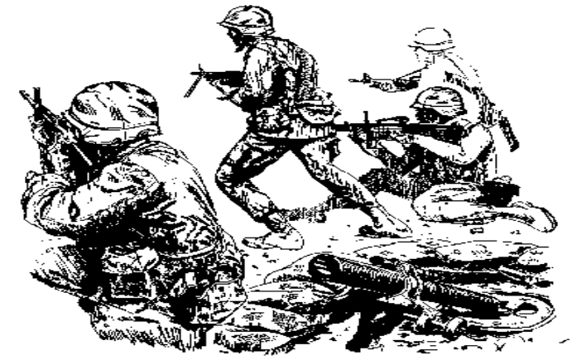
TACTICS
THE MEDIOCRE TEACHER TELLS. THE GOOD TEACHER EXPLAINS. THE SUPERIOR TEACHER DEMONSTRATES. THE GREAT TEACHER INSPIRES.
WILLIAM ARTHUR WARD

